Slide 1

Intelligent control technology
License plate recognition based on target detection and semantic
曾子涵

Slide 2
CONTENTS
1
Why choose this topic
2
License plate location based on target detection
3
License plate location based on semantic segmentation
4
License plate cutting and tilt correction
5
License plate character recognition
6
Summary

Slide 3
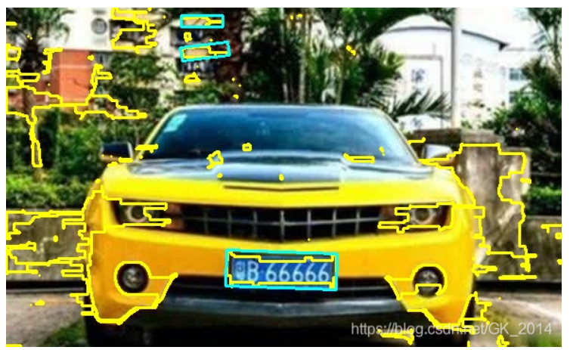
01
Why choose this topic
When you search for license plate recognition on Baidu, almost all methods use traditional image processing technologies, such as color feature analysis, edge detection technology and so on.
Moreover, there is almost no open-source license plate data on the network, resulting in almost all tutorials can not be used directly. Therefore, I hope to try some new methods through the open source data I can find.
edge detection

Slide 4
01
Realization idea
License plate location
Tilt correction
Character recognition
Object detection?
Correct after finding four vertices
Single character recognition or recognition together

Slide 5

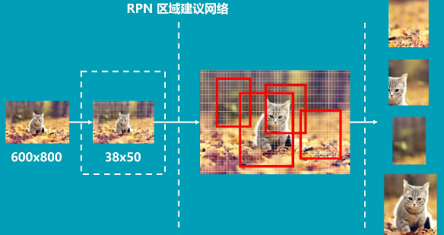
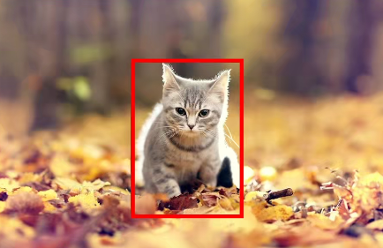
02
Target detection algorithm ---- Fast RCNN
600*800→38 * 50 characteristic layer → RPN regional recommendation network

Slide 6
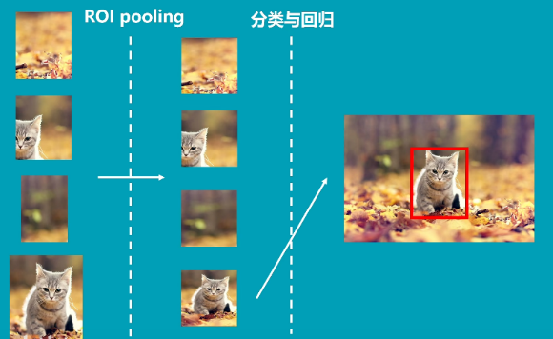
02
Target detection algorithm ---- Fast RCNN
ROI pooling → Classification and regression

Slide 7
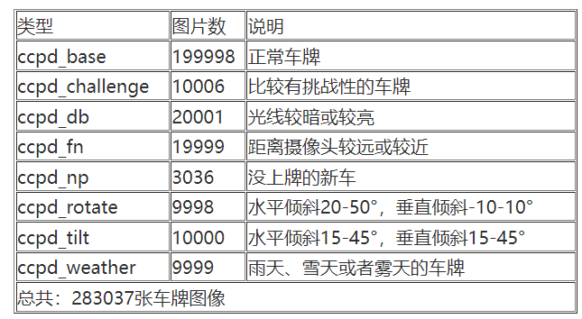
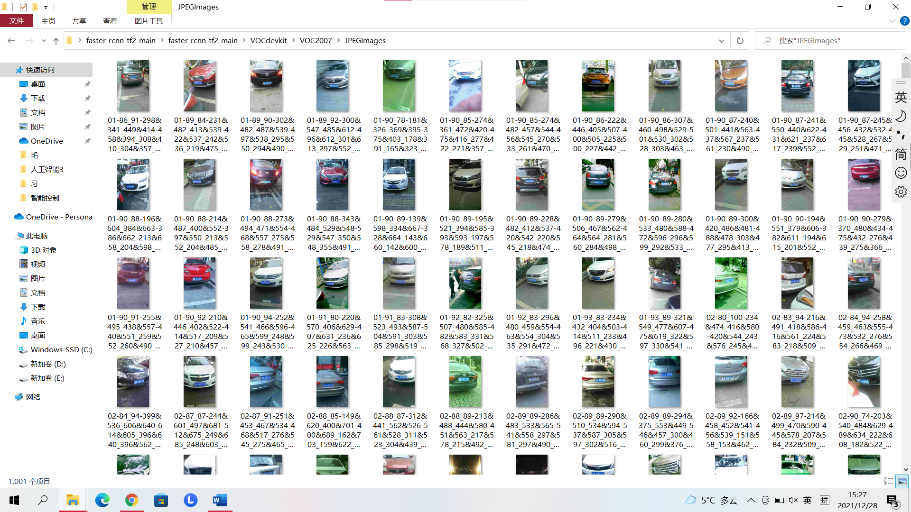
02
Target detection algorithm ---- Data preprocessing
CCPD dataset of China University of science and technology
https://github.com/detectRecog/CCPD
·The license plate location information is marked in the photo name
·I chose CCPD_ Base's 10000 photos for training

Slide 8
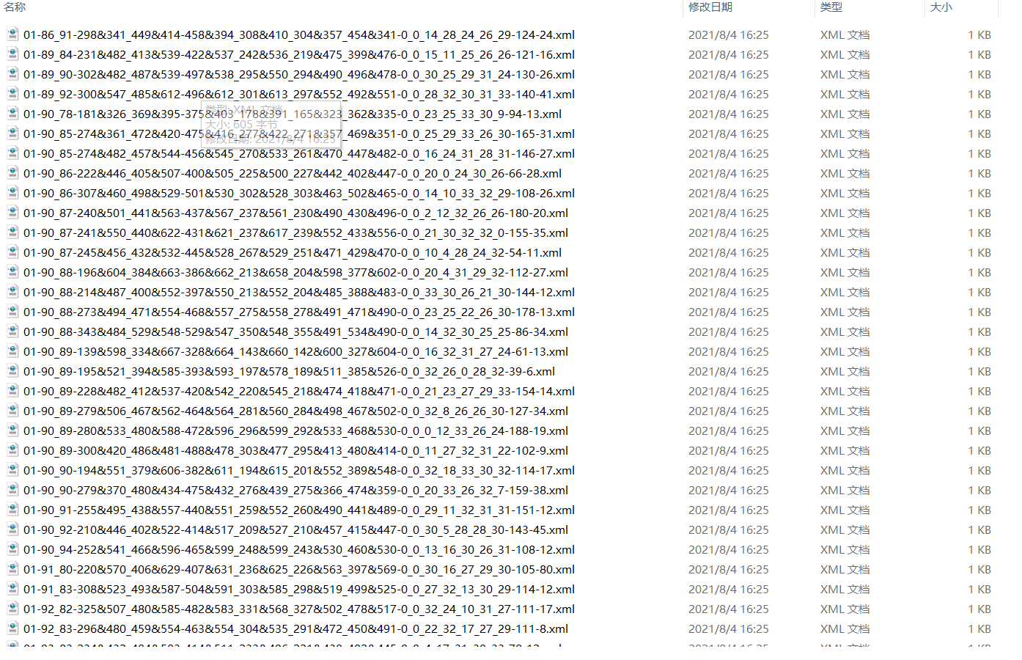
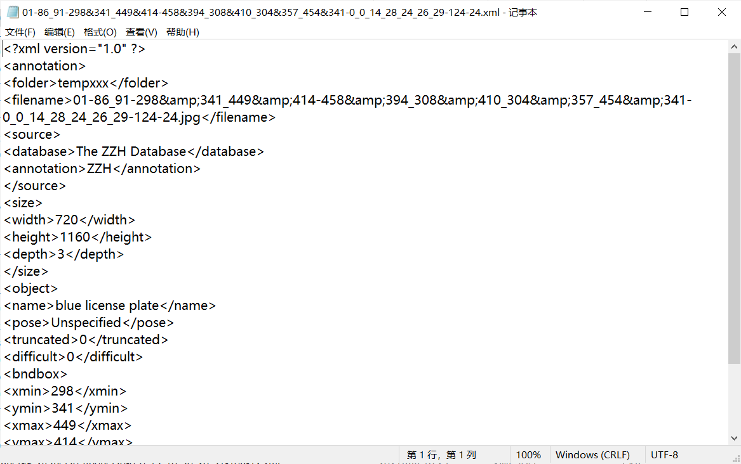
02
Target detection algorithm ---- Data preprocessing
There is no annotation file in the CCPD dataset, so I wrote a code to parse the photo name and generate an XML annotation file

Slide 9
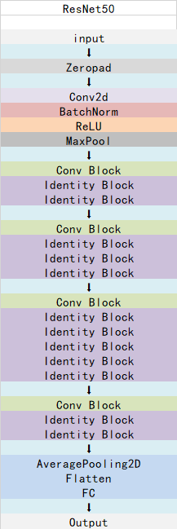
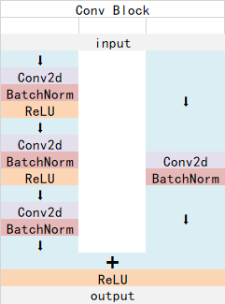
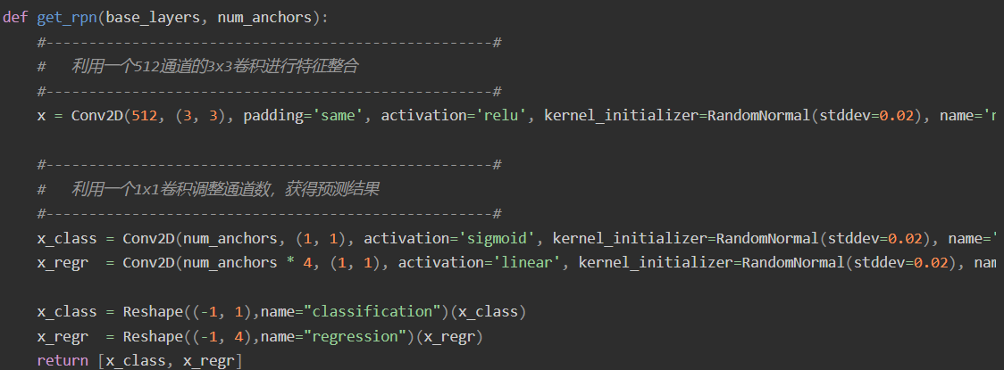
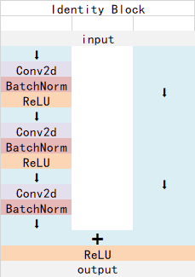
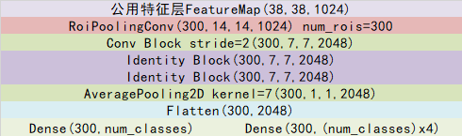
02
Target detection algorithm ---- network structure
RPN recommended network
Roipooling layer
Backbone feature extraction network (resnet50)

Slide 10
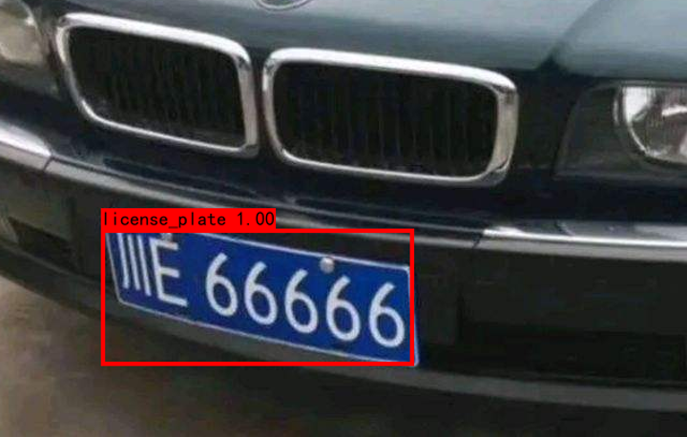
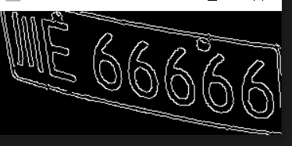
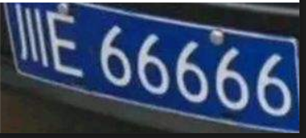
02
Target detection algorithm ---- Training results
This network is very time-consuming. After running on my classmate’s RTX 3060ti for a day and a night, I got a model with a loss of 0.0691 in the training set and 0.0675 in the verification set

Slide 11
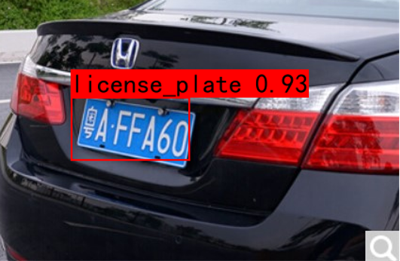
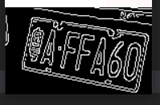
02
Target detection algorithm ---- run into a stone wall
My initial idea was to obtain the approximate location of the license plate through target detection, and then obtain the four vertices of the license plate through edge detection. However, for the license plate with too large tilt angle, it will cause a lot of interference and it is difficult to locate the vertex

Slide 12

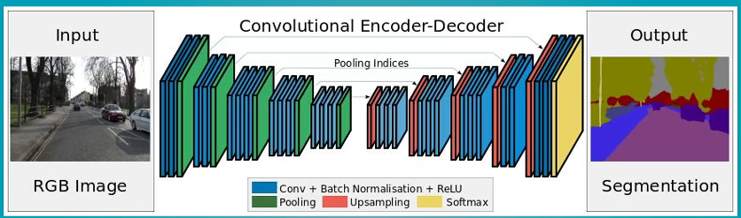
03
Semantic segmentation algorithm
If the target detection algorithm can tell us that there is a car and a person in the left picture, the semantic segmentation algorithm can accurately tell us which pixel in the picture is a car and which pixel is a person.
General process:

Slide 13
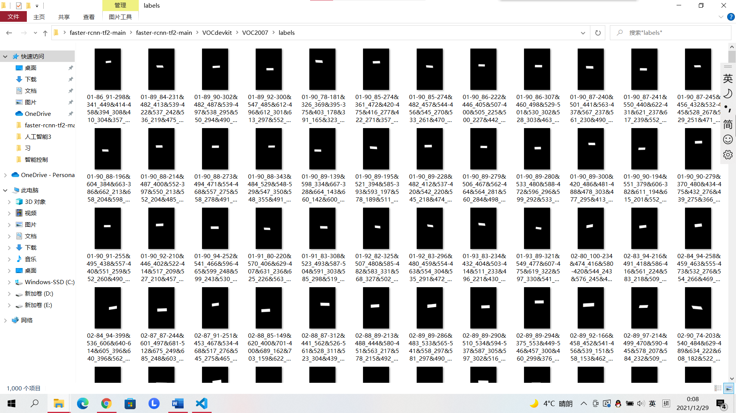
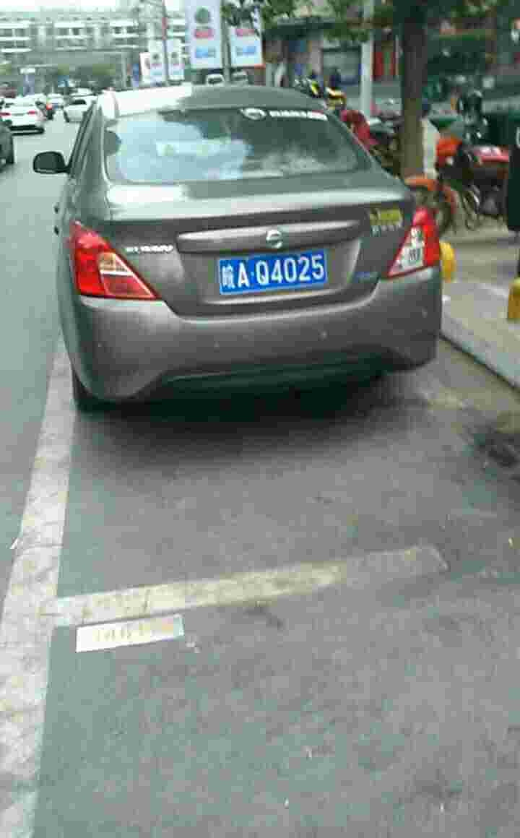
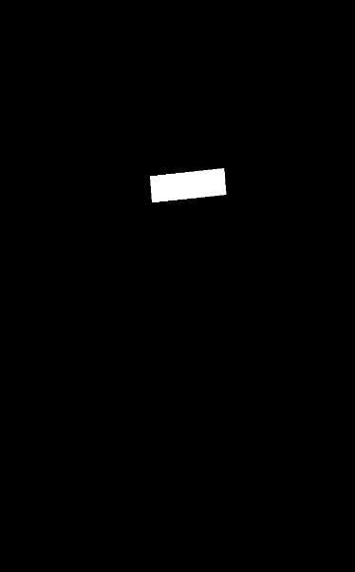
03
Semantic segmentation algorithm ---- Data preprocessing
In order to obtain the pixel information of the license plate position, I modified the previous analysis code and marked the pixel value corresponding to the license plate as 255. The final effect is as follows.

Slide 14
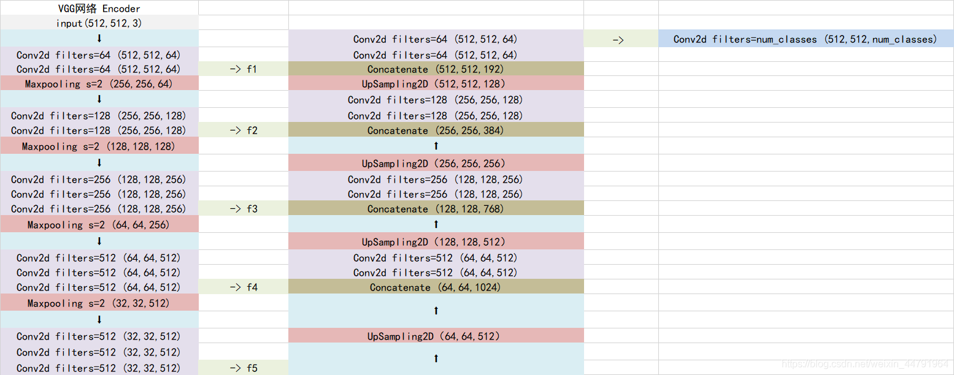
03
Semantic segmentation algorithm ---- network structure
UNET network structure

Slide 15
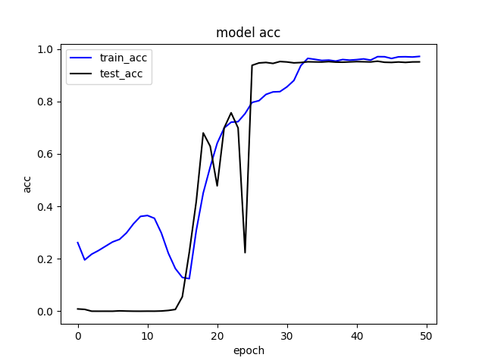
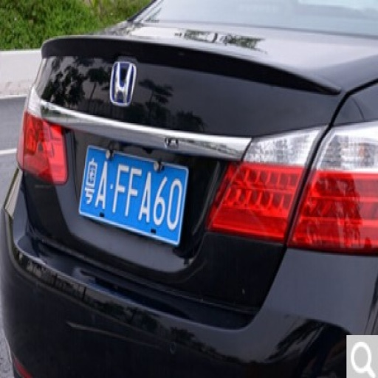

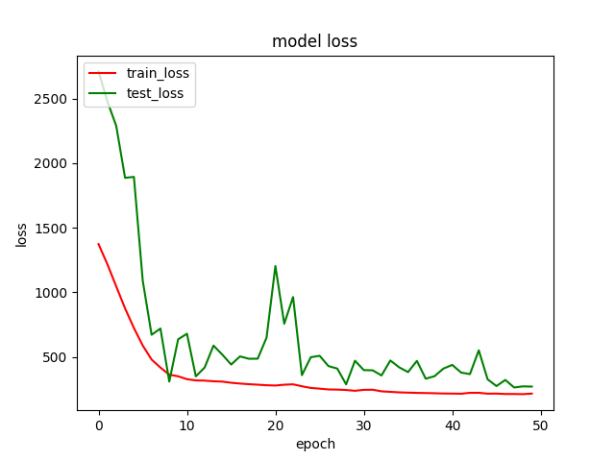
03
Semantic segmentation algorithm ---- Training results
input
output

Slide 16
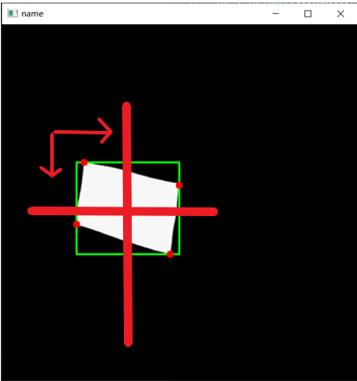
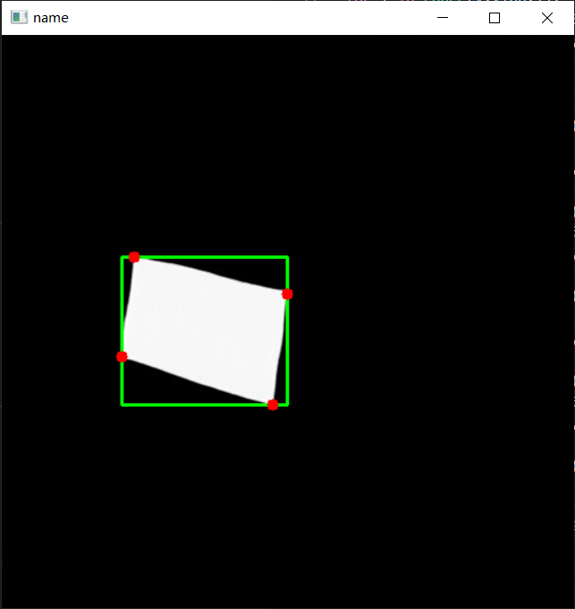

04
License plate corner extraction
In order to obtain corner information in the experiment, my first idea is to use cv2.boundingRect to obtains the minimum circumscribed rectangle of the license plate. At this time, you can imagine that the rectangle is composed of four parts. Start from the vertex of each part and look outside for whether there is an intersection. The final results are as follows:

Slide 17
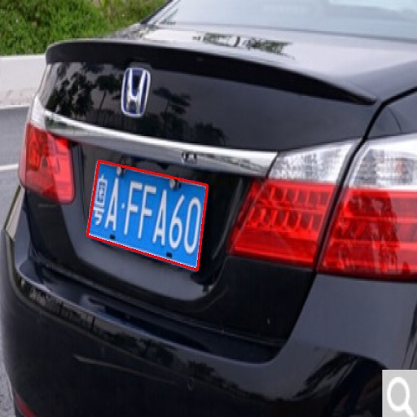
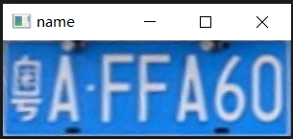
04
Tilt correction

Slide 18
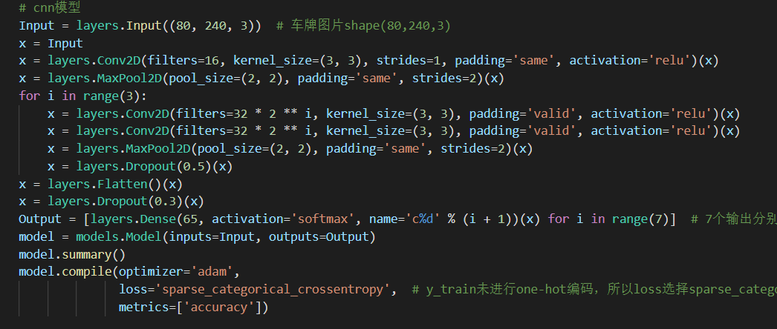
05
Character recognition ---- Network construction

Slide 19
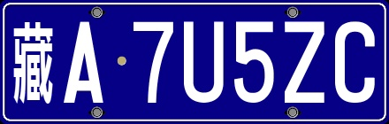
05
Character recognition ---- Data preprocessing
The real difficulty of license plate recognition is the search of data. In the previous process of license plate recognition, I used the open-source data set of China University of science and technology. Although this data set contains the information of license plates, there is a big problem, that is, because the collection place is from Hefei, almost all license plates are from Anhui a, which makes this data set almost unavailable. There is little information about the data set of the whole license plate on the Internet.
Fortunately, I found an open source project to forge Chinese license plates on the Internet（ https://github.com/ufownl/fake_chs_lp ）, you can output any license plate. The blue cards generated are as follows:

Slide 20
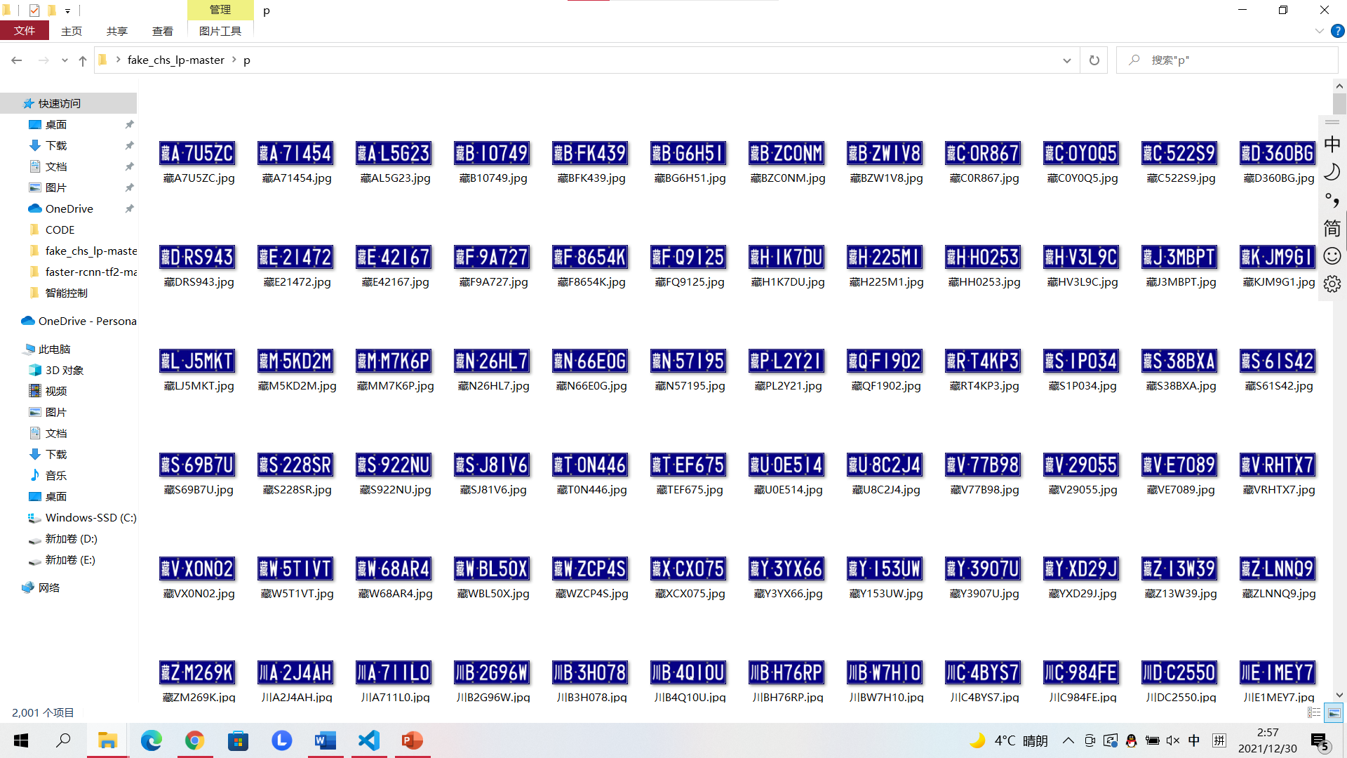
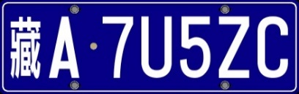
05
Character recognition ---- Data preprocessing
So I generated 2000 random license plate information for training, as shown in the figure below. The license plate information is saved in the form of file name.

Slide 21

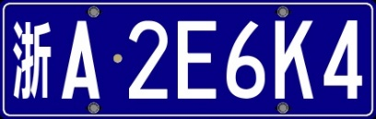

05
Character recognition ---- Data preprocessing
My initial idea was to use these 2000 random license plates to train the license plate recognition network, but after 100 rounds of iteration, I soon found the problem: the trained network has a high accuracy for identifying the same forged license plate, but it is almost impossible to recognize the real license plate.
After analyzing the reasons, I think the reason for this problem is that the 2000 license plates are too regular: the information of each license plate is very clear, and the location is very accurate, resulting in an almost unrecognizable phenomenon.
In order to solve this problem, I decided to enhance the data of these 2000 photos. I randomly rotate and translate these 2000 photos, add some noise to them, and blur them randomly. Finally, in order to eliminate the influence of color difference on judgment, I also binarized these 2000 pictures. The final effect pictures are as follows:

Slide 22
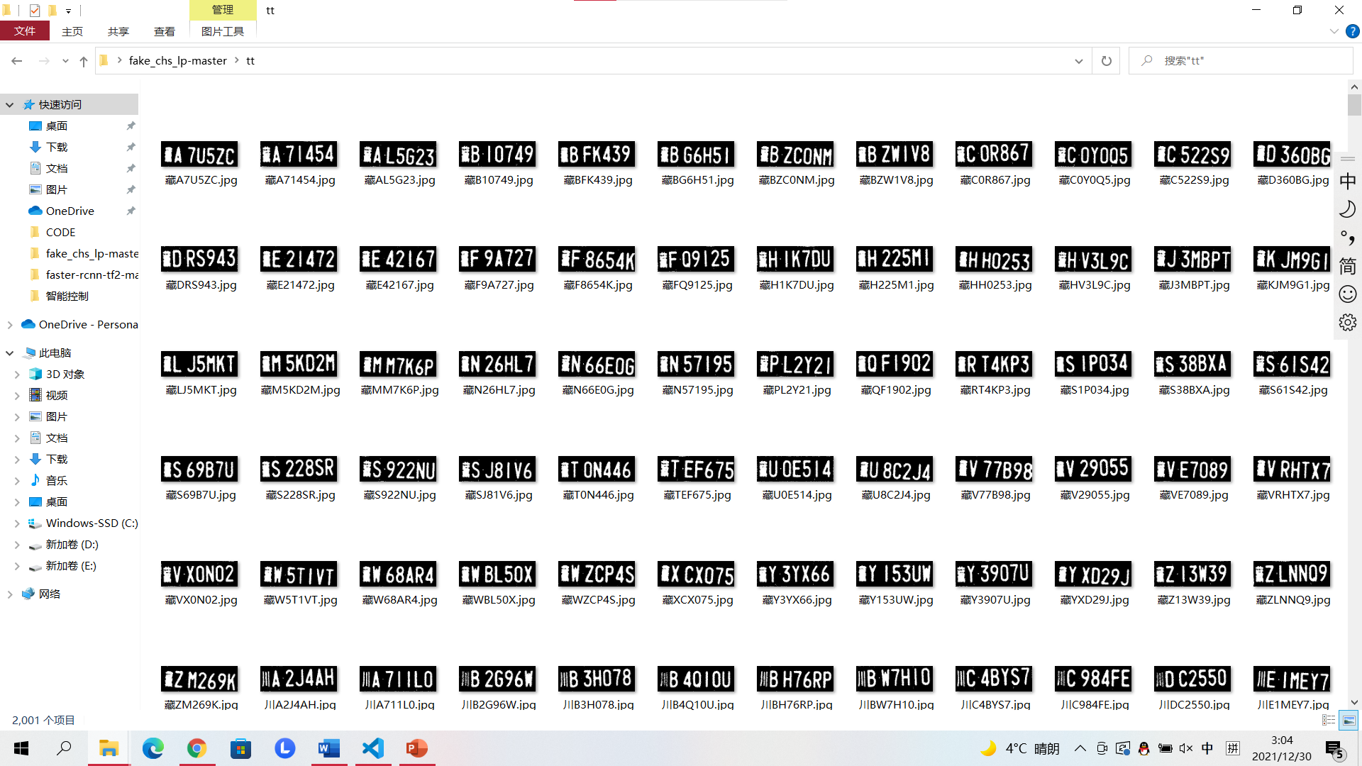
05
Character recognition ---- Data preprocessing

Slide 23
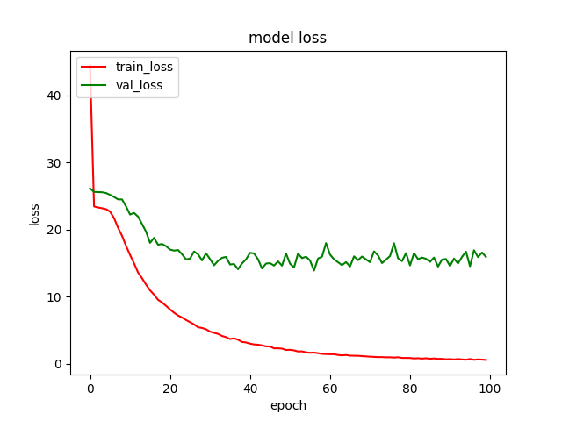
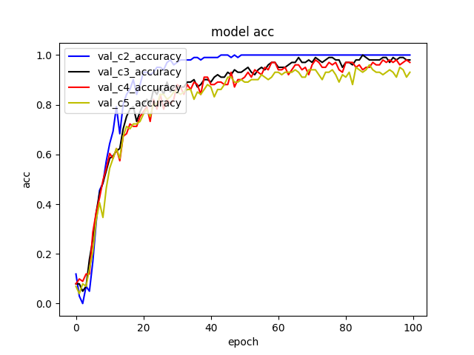
05
Character recognition ---- Training and testing

Slide 24
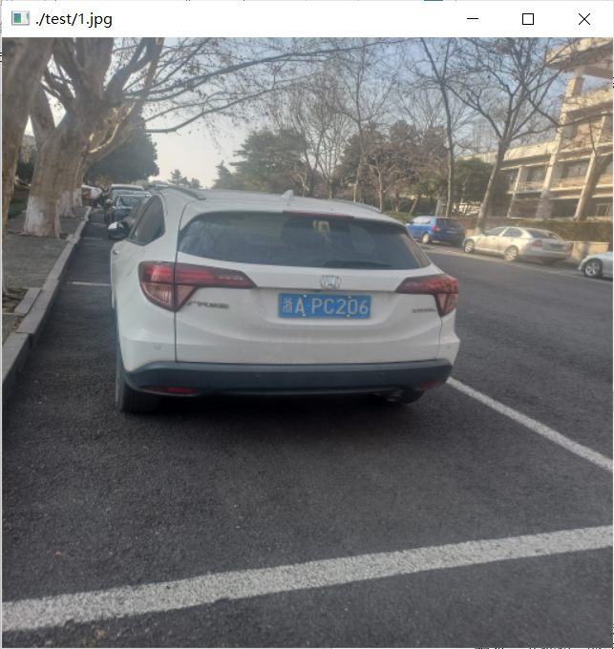
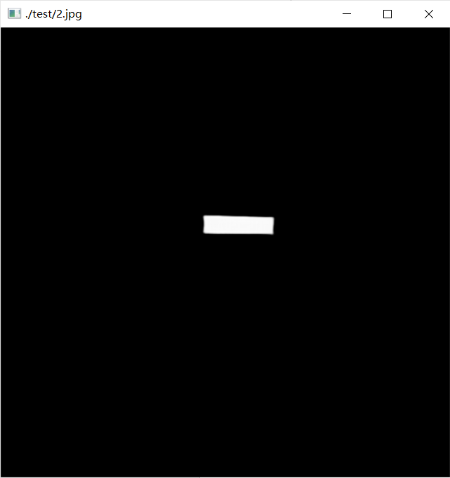
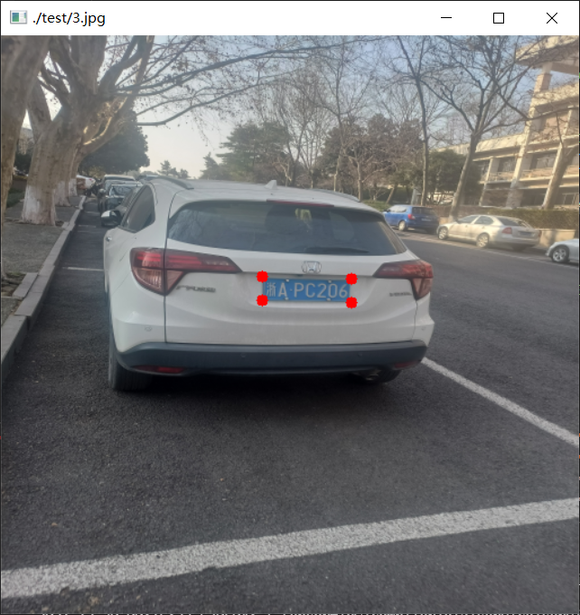
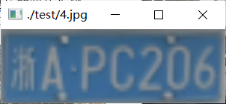
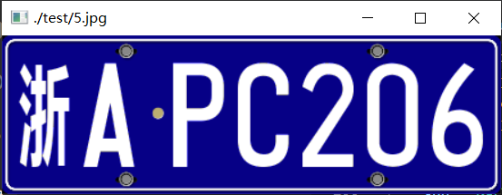
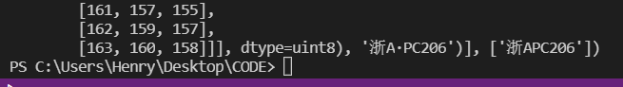
06
Final effect
input
Output of Unet
Corner extraction
Tilt correction
Character recognition

Slide 25
Intelligent control technology
THANKS!

Slide 26
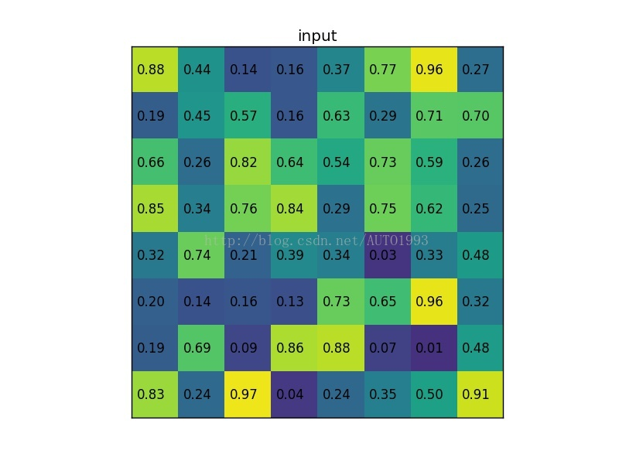

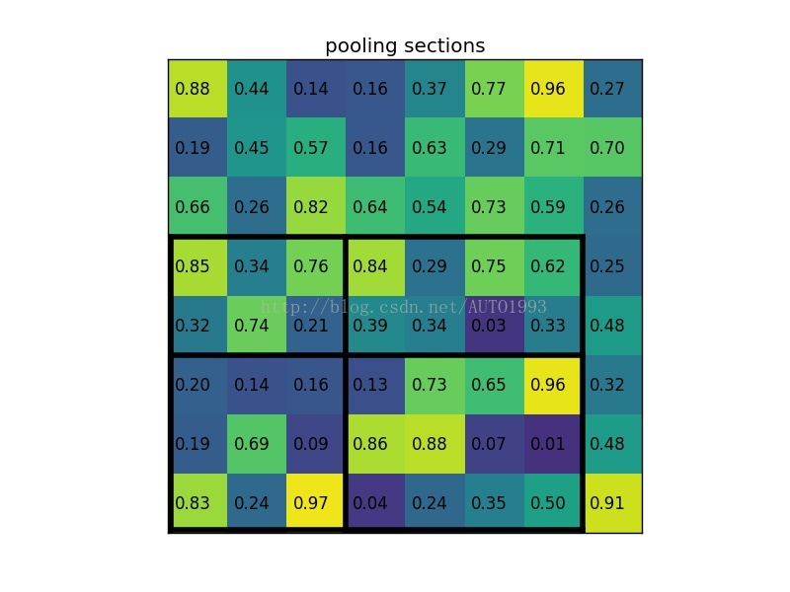
02
Target detection algorithm ---- Fast RCNN

Slide 27
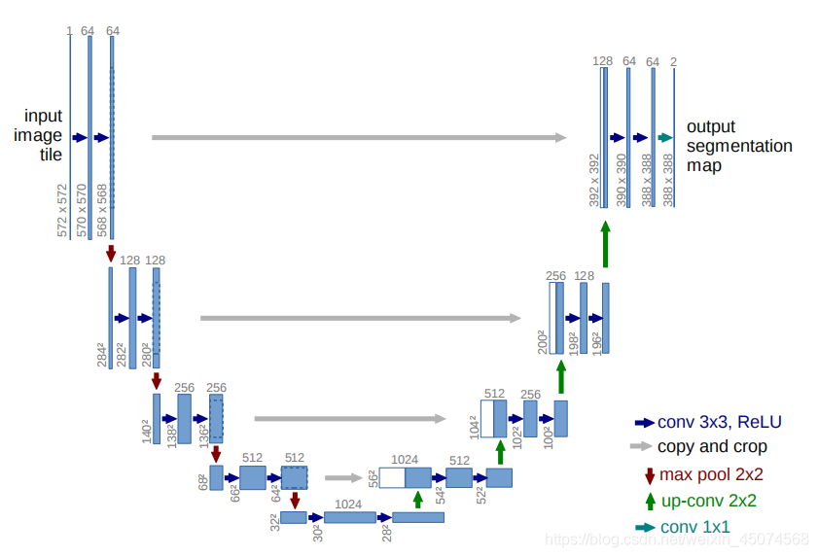

Slide 28
